Slide 1
JavaScript 2D Game
Mahmoud hassan ahmed mahmoud ali ahmed
Aya hassan mohamed Elsayed

Slide 2
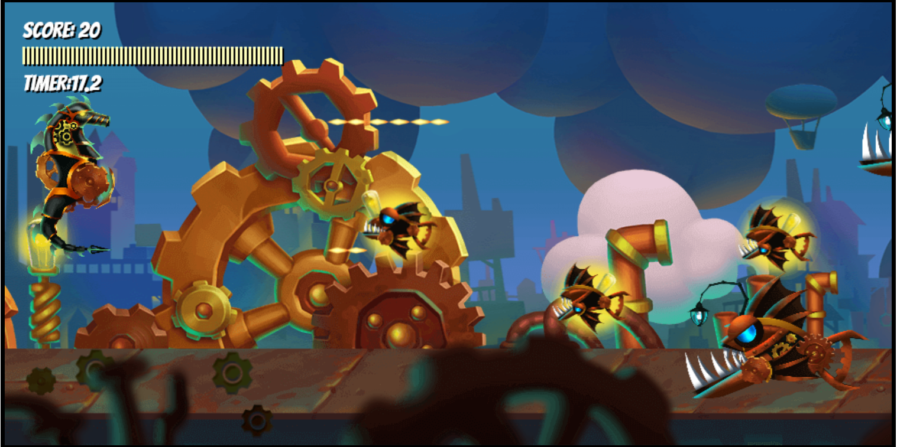

Slide 3
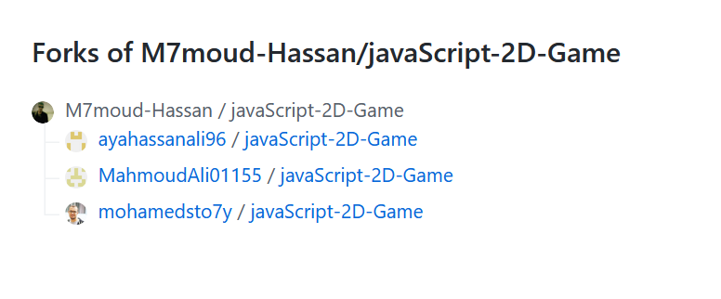
https://github.com/M7moud-Hassan/javaScript-2D-Game

Slide 4
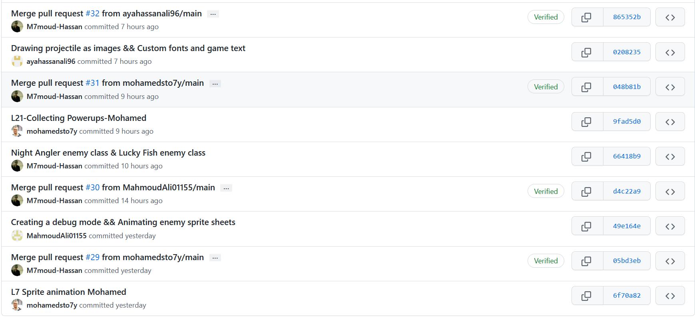
commits

Slide 5
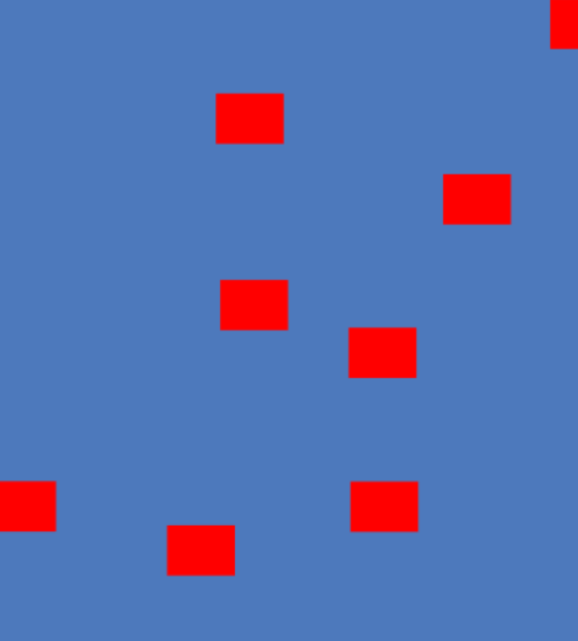
Enemy
Contain
Update
draw

Slide 6
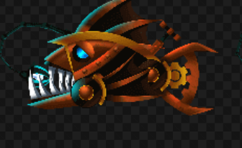

Angler1
Angler2

Slide 7

LuckyFish
This give player power

